Slide 1

Course Introduction
GEOG 371: Web Mapping
Bo Zhao Ph.D.
College of Earth, Ocean and Atmospheric Sciences
zhao2@oregonstate.edu

Slide 2
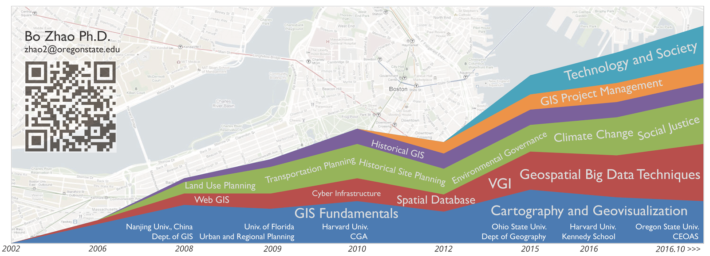
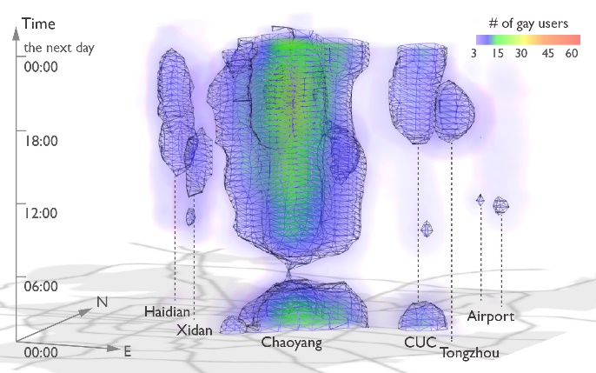
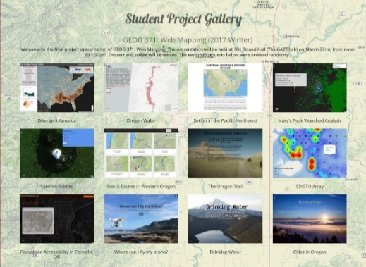
Teaching:
My goal is to help students efficiently and friendly communicate with the targeting audience using geovisualization.
Geog 370: Cartography
Geog 3/571: Web Mapping
Geog 4/572: Geovisual Analytics
Current Research:
Location-based Social Media; Location Spoofing
Storymap.js – a open source map storytelling library
Former Student Project Gallery
Visualization LGBT community in Beijing

Slide 3
Now, why are you here …?
So, why study Web Mapping?
Notes:
Now is your turn.

Slide 4
This course introduces concepts and techniques of web programming, digital storytelling, online project management, and web-based cartographic principles for developing, evaluating, and using web maps.
To promote the equal access to web mapping technology, we ensure all the web mapping applications from course materials can be opened, debugged or further developed in either Windows or Mac OSX operating systems, and all the relevant software or services are either open source or free.
This course is comprised of two major components, including lectures and lab exercises.
The lectures focus on the theories and principles behind web mapping, including system architecture, responsive user graphic design, map design and geo-narrative.
The lab exercises focus on practical skills for web programming, 2d and 3d web mapping, web mapping services, and digital storytelling.
In addition, there will be random quizzes focusing on prior lecture materials, a mid-term focusing on basic concepts and web programming techniques.
Although there is no final exam, but each student is expected to design a web map and deploy it to an openly accessible server (e.g., GitHub). From this course, students can learn both the principles of web-based cartography and the practical skills for web mapping, and develop the capabilities of map aesthetics and critique.
Programming Languages: Html, CSS, Javascript, Markdown and GeoJson
Desktop Software: Chrome, Webstorm, Typora, QGIS, and GeoServer
Web Services: GitHub, jsfiddle, Mapbox, W3Schools, and geojson.io
Libraries for Web Mapping: Jquery, Bootstrap, Leaflet, Storymap.js, and Cesium

Slide 5
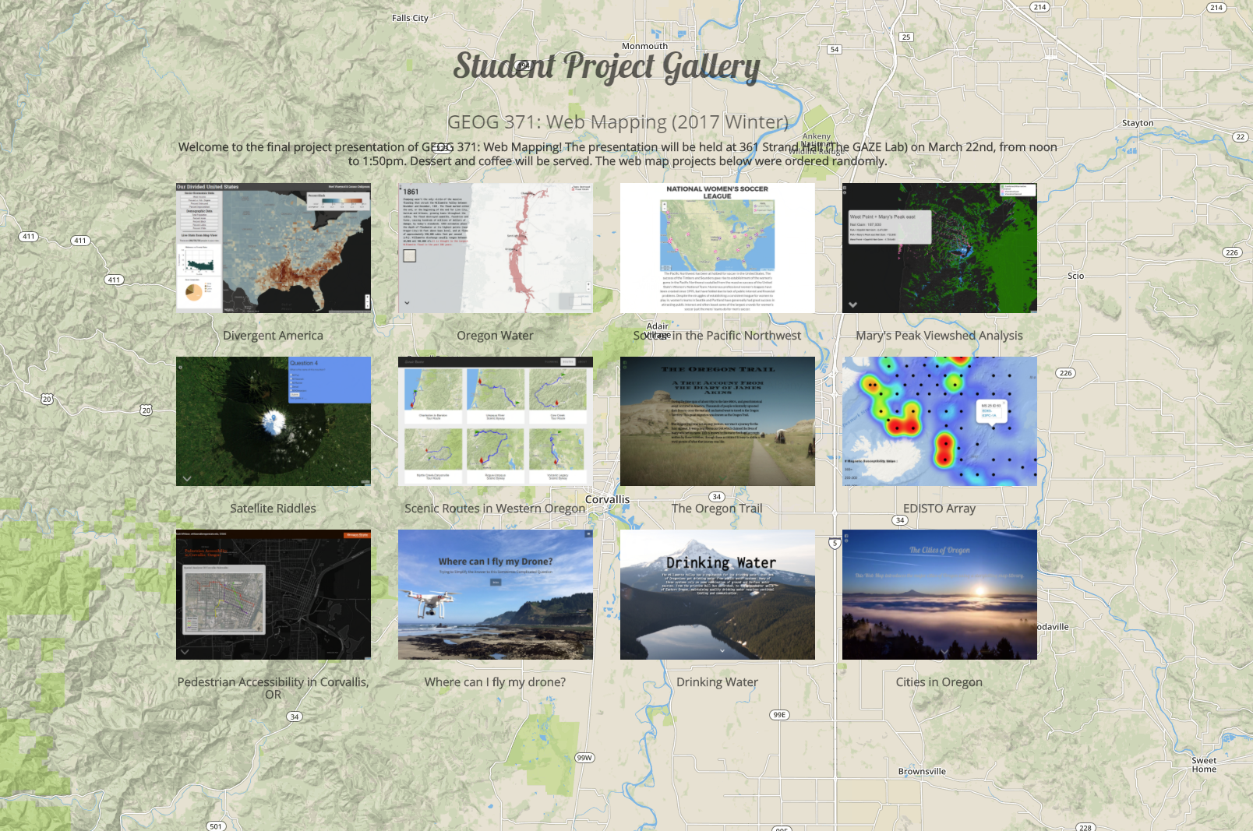
Student Project Gallery (2017 Winter)
http://geoviz.ceoas.oregonstate.edu/project_gallery/

Slide 6
Instructor: | Bo Zhao, zhao2@oregonstate.edu
Office Hour: | TBD or by appointment @ Strand Ag. Hall 347A
Web site: | https://github.com/jakobzhao/geog371
Text: | Required readings will be available on the course website.
Credits: | 4
Meeting: | Lecture: MWF 0900 - 0950 @Wilkinson 210; Lab: Th 0800 - 1150 @ Wilkinson 210.
Prerequisites: | GEOG 201 [C-]
Grades: | Letter grading (A to F)
Notes:
To be short,

Slide 7
Texts
No required textbook.
Required papers and online materials will be available on the course GitHub.

Slide 8
Syllabus
Week | Lecture (M) | Lecture (W) | Lab (M) | Lecture (F) | Reading
Wk 00 | Intro to the Course | Internet Fundamentals | Lab 1: Project Management for Web Mapping | Intro to Web Mapping | Markdown, Links and Command Lines
Wk 01 | Web Programming Basics I: HTML 5 and CSS | System Architecture for Web Mapping | Lab 2: Web Programming Basics II: Javascript | Web Programming Basics III: JQuery | HTML, CSS and Javascript
Wk 02 | MLK Day | Web Programming Basics III: Debugging | Lab 3: Web Map Design | Spatial Data for Web Mapping | Leaflet and GeoJson
Wk 03 | Map Client I: Basics and Geographic Features | Map Client II: Map Events and Mashup | Lab 3: Cont'd | Map Client III: Web Map Interaction | GeoServer Documentation
Wk 04 | Map Server I: Intro to GeoServer | Map Server II: Styling | Lab 4: Web Map Services and Basemap | Map Server III: Web Map Services | Bing Map Tile, WFS and WMS
Wk 05 | Map Server IV: Base Map Design using Mapbox | Map Server V: Map Tiles | Lab 4: Cont'd | Midterm Exam | Bootstrap Documentation
Wk 06 | Map Design I: Web Template and Framework | Map Design II: Bootstrap | Lab 5: Story Map | Storytelling with Web Map I | Web Map Design Principles
Wk 07 | Storytelling with Web Map II, cont'd with the last lecture | Map Design III: User Friendly Design Principles | Lab 5: Cont'd | Real-Time Mapping: TweetMap | Server Side JavaScript
Wk 08 | HeatMap | Map Design IV: Map Critiques | Lab 6: Thematic Map on a Virtual Globe | 3D Web Mapping I: Basics | Cesium Documentation
Wk 09 | 3D Web Mapping II: Build a Virtual Environment | 3D Web Mapping III: Thematic Map on a Virtual Globe | Final Project Discussion and Preparation | Emerging Topics on Web Mapping | Elwood et al. (2012), Sui and Zhao (2015)
Wk 10 | Final Project Discussion and Preparation | Final Project Discussion and Preparation | Final Project Discussion and Preparation | Final Project Presentation - Strand Ag Hall (GAZE) TBD | N/A

Slide 9
Grading
Item | Description | % of final grade
Attendance and Quizzes | Attendance; and 3-6 in-class and/or take-home quizzes covering topics from lecture and reading assignments. | 12
Lab Assignments | 6 lab assignments (9% each). We understand that many of the programming techniques discussed early in the course will be relatively new. Recognizing this, the first few assignments will contain more detailed instructions. | 54
Mid-term | Evaluating your understanding about the basic concepts of web mapping programming. It is a closed book exam and will cover material presented before the midterm. | 14
Final Project | Each student is required to write a report about an existing web map application, and make a presentation about it. This final project is mainly evaluated by both the presentation and the report. | 12
TOTAL |  | 100

Slide 10
Any questions?

